Slide 1
Community & Economic Development
2023 Recap

Slide 2
Community & Economic Development GRANTS TOURISM MOBILE APP & WEBSITE US EPA - BROWNFIELDS COMMUNITY ENGAGEMENT PCED CERTIFICATION YMCA LAND DONATION $1M

Slide 3
GRANTS
Awarded & Managed 13 Grants
$2,000,000 in funding
* Tourism * Recreation * Environment
* Economic Development
* Healthy Food Access
* Arts and Culture
* Downtown Revitalization

Slide 4
TOURISM
Excel By 5 Touch-A-Truck
Hernando Farmers Market
Water Tower 10K
Dickens of a Christmas
75+ volunteers / 37 sponsors $67,000
Children’s Health Fair

Slide 5
EXCEL BY 5
Prime Time Reading Time Grant: 6-week reading program for young children to strengthen families and communities through humanities. Program, meals and door prizes secured with grants & sponsors & volunteers.
1
Touch-A-Truck: 500+ visitors / 20 businesses. Food secured with sponsors and volunteers.
2
POP Program: Healthy eating at early age. $3,000 program secured through sponsors.
3
Children’s Health Fair: Annual health event at farmers market with hospitals, local & state health agencies and resources for families with kids.
4
Dolly Parton Imagination Library: 622 active children/ 652 graduated last year.
5
Early Literacy Initiative: Dispersed 1,500 children’s book giveaways at events. Early Literacy Initiative costs $19,000 annually. Secured with grants and sponsors.
6

Slide 6
Water Tower 10K
488 - Runners
46 - Cities
9 – States
21 Sponsors/ $28K Secured
$20,000 - Proceeds
Dolly Parton Imagination Library

Slide 7
Hernando Farmers Market
28 Saturdays
8AM-1Pm
$600K sales farmers & vendors
Double Up Bucks SNAP grant/ Prescription Rx grant
Senior and Children’s Day activities.
Entertainment
26 Saturdays
Local businesses more visitors increased sales

Slide 8
Dickens of a Christmas Friday-Sunday
11.8K Visitors (data geofenced with Placer A.I.)
17 part-time/temporary jobs created
Local businesses increased sales from prior year. Increased sales tax revenue.
New: Ghost Tour, DFT family event, Memphis Fire Museum fire truck, children’s train, Beer Garden benefiting Hernando Parks & Recreation Foundation. More than 20 activities scheduled.
23 Sponsors/ $30K Secured

Slide 9
WEBSITE * MOBILE APP
Website redesign completed. New user-friendly features for desktop and mobile view.
Mobile App users increased from 500 to 2,000 with 42-zip codes
Public events being added regularly. Positive community engagement.

Slide 10
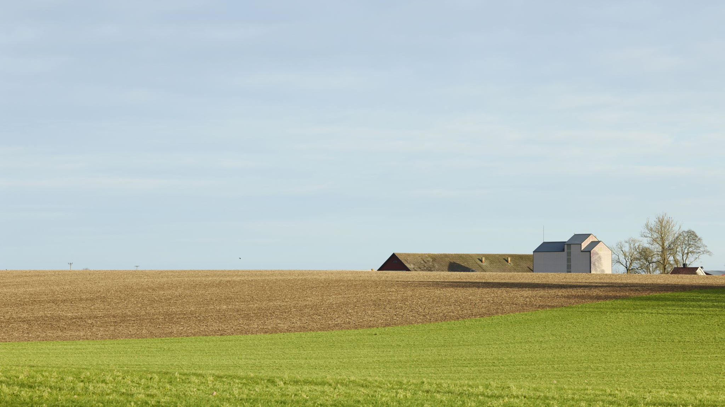
US EPA BROWNFIELDS Environment and Economic Development
Awarded $409,000 US EPA Assessment Grant in 2022
Funding to assist private landowners and developers for redevelopment and revitalization of underutilized or abandoned properties.
7 - properties utilizing program.
$128,000 spent/ $281,000 available for assessments

Slide 11
Community & Economic Development 2024
Look for opportunities that create and enhance a safe, livable and vibrant community for residents, businesses and visitors.

